Slide 1
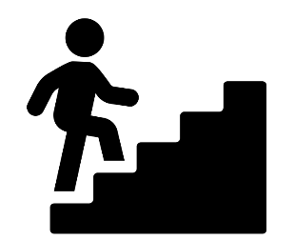



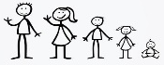



Written GCSE exams
Saying where people go (countries)
GCSE speaking exams
French Curriculum map
Revision
Mock exams
Exam skills practice
Technology & staying safe online
Post-16 mock exams
Describing places
Revision
YEAR
Festivals, celebrations & traditions
Our towns & homes
11
French interaction day
Relationships
The planet & the local environment
The Internet & the digital world
Gap years & holidays
Y10 exams & feedback
Celebrities
Work experience
TV, cinema & music
Personal qualities
Different types of families
Health problems
School subjects
Friends and friendships – qualities and problems
YEAR
Your future plans
food choices
10
Paris immersion Trip
Different types of families
Different partnerships – pros & cons
Friends & friendships – qualities & problems
Sporting activities & ways of keeping fit
Different partnerships – pros and cons
Personality descriptions
Present lifestyle choices & future intentions
Personality descriptions
Your future plans
Jobs & personal qualities
Opinions on fast-food & cooking
Food & drink
Talking about what people do in their free time
Translation Bee
Paris immersion Trip
Expressing opinions about hobbies
Sporting activities
Drugs & alcohol
Working abroad & using language skills
Holidays, past & present
Reading
Films & actors
YEAR
Music & singers
9
Weather & future plans
Television programmes
Sport
Holidays & holiday locations
Giving opinions on places
Saying what you can do in your area
Expressing opinions about hobbies
Paris immersion Trip
Describing people
Saying where you’d like to live
Christmas card competition
Name, nationality & age
Giving opinions on places
Saying where you go
Describing where you live
Family & friendships
YEAR
8
Describing where you live
Saying where you go
Saying where you’d like to live
Easter in France
Saying what you can do in your area
Giving opinions on places
Expressing opinions about hobbies
Family & friendships
YEAR
Describing people
Christmas card competition
International Talent evening
7
Name, nationality & age.
One language sets you in a corridor for life. Two languages open every door along the way

